Slide 1

PROGRAMMING METHODOLOGY (PHƯƠNG PHÁP LẬP TRÌNH)
UNIT 2: Algorithmic Problem Solving

Slide 2
Acknowledgement
The contents of these slides have origin from School of Computing, National University of Singapore.
We greatly appreciate support from Mr. Aaron Tan Tuck Choy for kindly sharing these materials.

Slide 3
Policies for students
These contents are only used for students PERSONALLY.
Students are NOT allowed to modify or deliver these contents to anywhere or anyone for any purpose.

Slide 4
Recording of modifications
Currently, there are no modification on these contents.

Slide 5
Unit 2: Algorithmic Problem Solving
Problem Solving Process
Algorithm
Control Structures
Examples of Pseudocodes
Euclid’s Algorithm

Slide 6
Problem Solving Process
Analysis
Iterative process
Design
Implementation
Testing

Slide 7

Problem Solving Process
Analysis
Iterative process
Design
Implementation
Testing

Slide 8
Problem Solving Process
Algorithmic
Determine problem features
Analysis
Iterative process
Write algorithm
Design
Produce code
Implementation
What is an algorithm?
Check for correctness and efficiency
Testing

Slide 9
Algorithm (1/3)
An algorithm is a well-defined computational procedure consisting of a set of instructions, that takes some value or set of values as input, and produces some value or set of values as output.
Algorithm
Input
Output
‘Algorithm’ stems from ‘Algoritmi’, the Latin form of al-Khwārizmī, a Persian mathematician, astronomer and geographer.
Source: http://en.wikipedia.org/wiki/Algorithm

Slide 10
Algorithm (2/3)
An algorithm has these properties:
The algorithm must terminate.
(Or no solution will be obtained.)
Each step must be exact. (Or it will not be precise.)
Exact
Terminate
The algorithm must be effective.
(i.e. it must solve the problem.)
Effective
General
The algorithm must be general.
(Within the constraints of the system/language.)

Slide 11
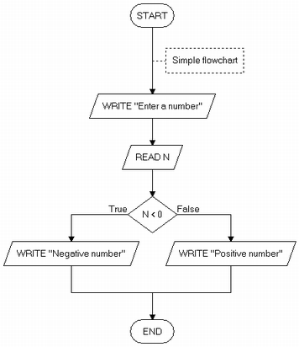
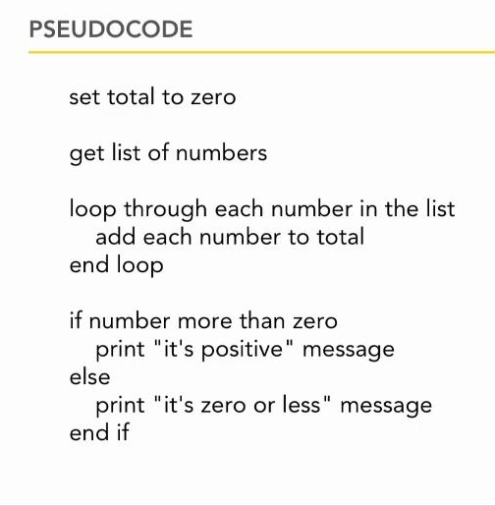
Algorithm (3/3)
Ways of representing an algorithm:
Flowchart
Pseudocode
lynda.com

Slide 12
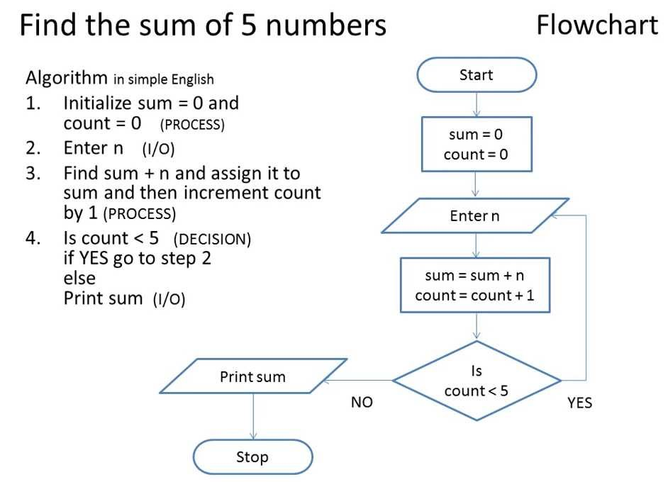
Algorithm: Example #1

Slide 13
Algorithm: Example #2 (1/2)
Find maximum and average of a list of numbers:
Terminator box
Flowchart
start
Process box
sum 🡨 count 🡨 0
max 🡨 0
Decision box
Yes
end of input?
No
Enter num
increment count
sum 🡨 sum + num
ave 🡨 sum/count
print max, ave
num > max?
Yes
max 🡨 num
No
end

Slide 14
Algorithm: Example #2 (2/2)
Find maximum and average of a list of numbers:
Pseudocode
The need to initialise variables.
sum 🡨 count 🡨 0 // sum = sum of numbers
// count = how many numbers are entered?
max 🡨 0 // max to hold the largest value eventually
for each num entered,
count 🡨 count + 1
sum 🡨 sum + num
if num > max
then max 🡨 num
ave 🡨 sum / count
print max, ave
The need to indent.
Are there any errors in this algorithm?

Slide 15
Algorithm: Pseudocode
We will write algorithms in pseudocode instead of flowchart as the former is more succinct
However, there are no standard rules on how pseudocodes should look like
General guidelines:
Every step must be unambiguous, so that anybody is able to hand trace the pseudocode and follow the logic flow
Use a combination of English (keep it succinct) and commonly understood notations (such as 🡨 for assignment in our previous example)

Slide 16
Control Structures (1/2)
An algorithm is a set of instructions, which are followed sequentially by default.
However, sometimes we need to change the default sequential flow.
We study 3 control structures.

Slide 17
Control Structures (2/2)
Sequence
Default
Selection
Also called branching
True
False
?
Repetition
Also called loop
False
?
True

Slide 18
Data Representation
Internal representation: bits (binary digits) 0 and 1
1 byte = 8 bits
In programming, we need variables to hold data. A variable has an associated data type and occupies memory space. In the following slides, variables are shown as boxes.
Some data types in C (list is not exhaustive)
Integers: int, short, long (int is most common)
Real numbers: float, double
Characters: char
Self-reading: Lesson 1.4 in reference book

Slide 19

Control Structures: Sequence (1/2)
Task: Compute the average of three integers
A possible algorithm:
enter values for num1, num2, num3
ave 🡨 ( num1 + num2 + num3 ) / 3
print ave
Variables used:
num1
num2
num3
ave
Another possible algorithm:
enter values for num1, num2, num3
total 🡨 ( num1 + num2 + num3 )
ave 🡨 total / 3
print ave
Variables used:
num1
num2
num3
total
ave
Each box represents a variable.
Important concepts: Each variable has a unique name and contains a value.

Slide 20
Control Structures: Sequence (2/2)
Task: Compute the average of three integers
How the program might look like
Unit2_prog1.c
// This program computes the average of 3 integers
#include <stdio.h>
int main(void) {
int num1, num2, num3;
float ave;
printf("Enter 3 integers: ");
scanf("%d %d %d", &num1, &num2, &num3);
ave = (num1 + num2 + num3) / 3.0;
printf("Average = %.2f\n", ave);
return 0;
}

Slide 21
Control Structures: Selection (1/3)
True
False
?
Task: Arrange two integers in ascending order (sort)
Algorithm A:
enter values for num1, num2
// Assign smaller number into final1,
// and larger number into final2
if (num1 < num2)
then final1 🡨 num1
final2 🡨 num2
else final1 🡨 num2
final2 🡨 num1
// Transfer values in final1, final2 back to num1, num2
num1 🡨 final1
num2 🡨 final2
// Display sorted integers
print num1, num2
Variables used:
num1
num2
final1
final2

Slide 22
Control Structures: Selection (2/3)
True
False
?
Task: Arrange two integers in ascending order (sort)
Algorithm B:
enter values for num1, num2
// Swap the values in the variables if necessary
if (num2 < num1)
then temp 🡨 num1
num1 🡨 num2
num2 🡨 temp
// Display sorted integers
print num1, num2
Variables used:
num1
num2
temp
Compare Algorithm A with Algorithm B.

Slide 23
Control Structures: Selection (3/3)
True
False
?
How the program might look like for Algorithm B
Unit2_prog2.c
// This program arranges 2 integers in ascending order
#include <stdio.h>
int main(void) {
int num1, num2, temp;
printf("Enter 2 integers: ");
scanf("%d %d", &num1, &num2);
if (num2 < num1) {
temp = num1; num1 = num2; num2 = temp;
}
printf("Sorted: num1 = %d, num2 = %d\n", num1, num2);
return 0;
}

Slide 24
Control Structures: Repetition (1/3)
False
?
True
Task: Find sum of positive integers up to n (assume n>0)
Algorithm:
enter value for n
// Initialise a counter count to 1, and ans to 0
count 🡨 1
ans 🡨 0
while (count <= n) do
ans 🡨 ans + count // add count to ans
count 🡨 count + 1 // increase count by 1
// Display answer
print ans
Variables used:
n
count
ans
Initialisation is very important!

Slide 25
Control Structures: Repetition (2/3)
False
?
True
Important to trace pseudocode to check its correctness
Algorithm:
enter value for n
count 🡨 1
ans 🡨 0
while (count <= n) do
ans 🡨 ans + count
count 🡨 count + 1
// Display answer
print ans
Assume user enters 3 for n.
(count <= n)?
count
ans
1
0
true
2
1
true
3
3
true
4
6
false
Output: 6

Slide 26
Control Structures: Repetition (3/3)
False
?
True
How the program might look like
Unit2_prog3.c
// Computes sum of positive integers up to n
#include <stdio.h>
int main(void) {
int n; // upper limit
int count=1, ans=0; // initialisation
printf("Enter n: ");
scanf("%d", &n);
while (count <= n) {
ans += count;
count++;
}
printf("Sum = %d\n", ans);
return 0;
}

Slide 27
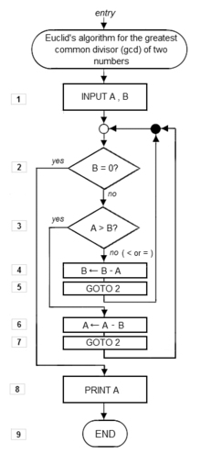
Euclid’s Algorithm (1/3)
To compute the greatest common divisor (GCD) of two integers
First documented algorithm by Greek mathematician Euclid in 300 B.C.
Also known as Euclidean Algorithm
1. Let A and B be integers with A > B ≥ 0.
2. If B = 0, then the GCD is A and algorithm ends.
3. Otherwise, find q and r such that
A = q.B + r where 0 ≤ r < B
4. Replace A by B, and B by r. Go to step 2.

Slide 28
Euclid’s Algorithm (2/3)
q is not important; r is the one that matters.
r could be obtained by A modulo B (i.e. remainder of A / B)
1. Let A and B be integers with A > B ≥ 0.
2. If B = 0, then the GCD is A and algorithm ends.
3. Otherwise, find q and r such that
A = q.B + r where 0 ≤ r < B
4. Replace A by B, and B by r. Go to step 2.
Assumption on A > B unnecessary
We will rewrite the algorithm

Slide 29
Euclid’s Algorithm (3/3)
Euclid’s algorithm rewritten in modern form
// Assume A and B are non-negative
// integers, but not both zeroes.
Algorithm GCD(A, B) {
while (B > 0) {
r 🡨 A modulo B
A 🡨 B
B 🡨 r
}
result is A
}
Let’s trace GCD(12, 42)
(B > 0)?
r
A
B
12
42
true
12
42
12
true
6
12
6
true
0
6
0
false
Result: 6

Slide 30
Summary
In this unit, you have learned about
The process of algorithmic problem solving
The properties of an algorithm
The three control structures
How to write algorithms in pseudocode
Tracing algorithms to verify their correctness

Slide 31
End of File

Slide 32


